Slide 1

Digital Banking Fraud Detection Simulation Engine
Real-Time Fraud Monitoring and Alert Analysis
Team 2: Adimulam Mourya Ashwitha Punyavathi Dhruv Dhanush

Slide 2


CHALLENGE
The Growing Threat of Digital Banking Fraud
The Challenge
The Opportunity
Digital banking fraud has escalated dramatically with the rise of online transactions, creating unprecedented risks for financial institutions and customers alike.
Modern fraud detection requires automated, intelligent systems that combine machine learning capabilities with rule-based detection frameworks.
Manual review processes struggle to keep pace with the volume and sophistication of fraudulent activities, leaving critical gaps in security coverage.
Real-time monitoring and rapid response mechanisms are essential to protect customers and minimise financial losses across digital banking platforms.

Slide 3
OBJECTIVES
Project Objectives
Build Simulation Engine
Detect Anomalies
Develop a comprehensive fraud detection system capable of processing transactions in real-time
Implement hybrid detection using rule-based logic and machine learning models
Enable Alert Review
Prioritise Intelligently
Create intuitive UI for fraud analysts to investigate and action alerts efficiently
Rank alerts by risk severity to optimise analyst workflow and response times

Slide 4






System Architecture Overview
Transaction Simulator
Generates realistic transaction patterns
Feature Extractor
Processes raw data into analytical features
Rule Engine
Applies fraud detection rules
ML Scoring
Generates risk scores using trained models
Alert System
Creates prioritised alerts for review
Dashboard UI
Enables analyst investigation

Slide 5

Transaction Data Sources
Data Generation Approach
Key Transaction Fields
Transaction ID: Unique identifier for each transaction
The system utilises both synthetic and real-world transaction datasets to ensure comprehensive testing and validation of fraud detection capabilities.
User Information: Customer account and profile details
Amount: Transaction value in applicable currency
Location Data: Geographic coordinates and country codes
Synthetic data allows controlled testing of edge cases and known fraud patterns without privacy concerns.
Timestamp: Precise transaction date and time
Device & IP: Technical metadata for device fingerprinting

Slide 6

DETECTION RULES
Rule-Based Fraud Detection Logic
The rule engine applies multiple detection heuristics to identify suspicious transaction patterns in real-time.
1
High Amount Threshold
Flags transactions exceeding predefined limits based on account history and transaction type
2
Velocity Detection
Identifies unusual transaction frequency patterns within defined time windows
3
Geographic Anomalies
Detects country mismatches and impossible travel scenarios based on location data
4
Device & IP Risk Scoring
Evaluates device fingerprints, IP reputation, and access pattern consistency

Slide 7


Machine Learning Risk Scoring
Model Architecture
The system employs ensemble methods including Random Forest and XGBoost classifiers to generate fraud probability scores.
These models are trained on historical transaction data with known fraud labels, learning complex patterns that rules alone cannot capture.
Feature Engineering
Transaction velocity metrics (hourly, daily)
Amount deviation from user baseline
Geographic distance calculations
Time-based behavioural patterns
Device and session consistency scores
Risk Score Interpretation: Model outputs range from 0.0 (lowest risk) to 1.0 (highest risk), with thresholds calibrated to balance false positives and detection rates.

Slide 8

Intelligent Alert Generation
01
Rule Trigger Identification
System captures which specific detection rules were violated by each transaction
02
ML Score Threshold Check
Evaluates whether machine learning risk score exceeds configured sensitivity threshold
03
Combination Logic Application
Determines whether rule violations alone, ML score alone, or combined signals trigger an alert
04
Priority Assignment
Calculates alert severity based on number of rules triggered, ML confidence, and transaction amount
Alerts are enriched with contextual metadata including triggered rules, risk scores, and customer history to support efficient analyst review.

Slide 9
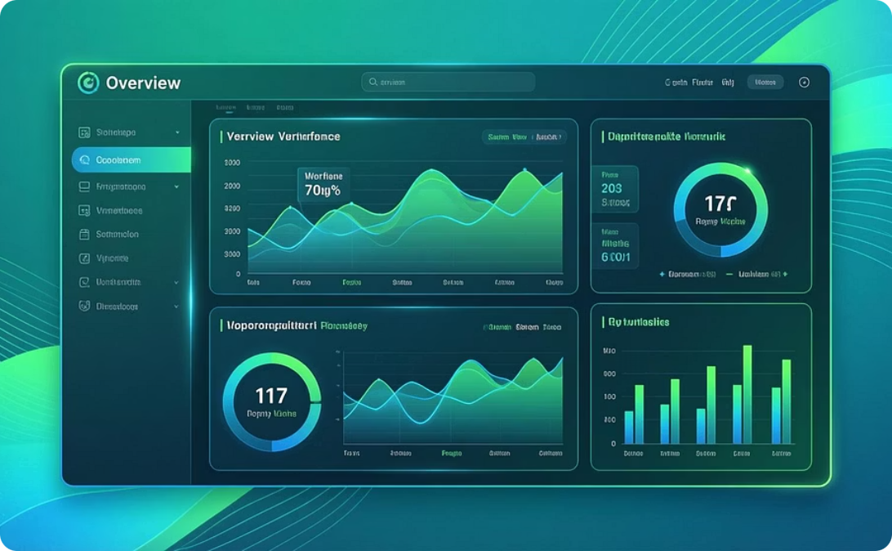
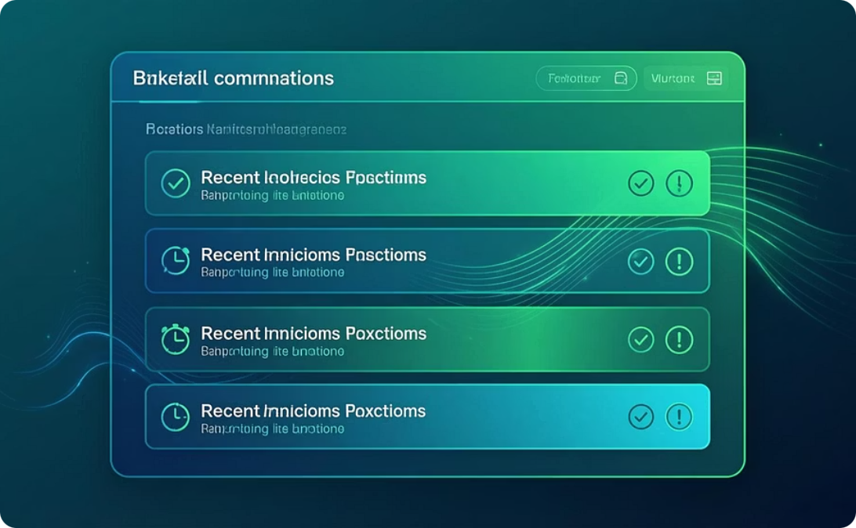
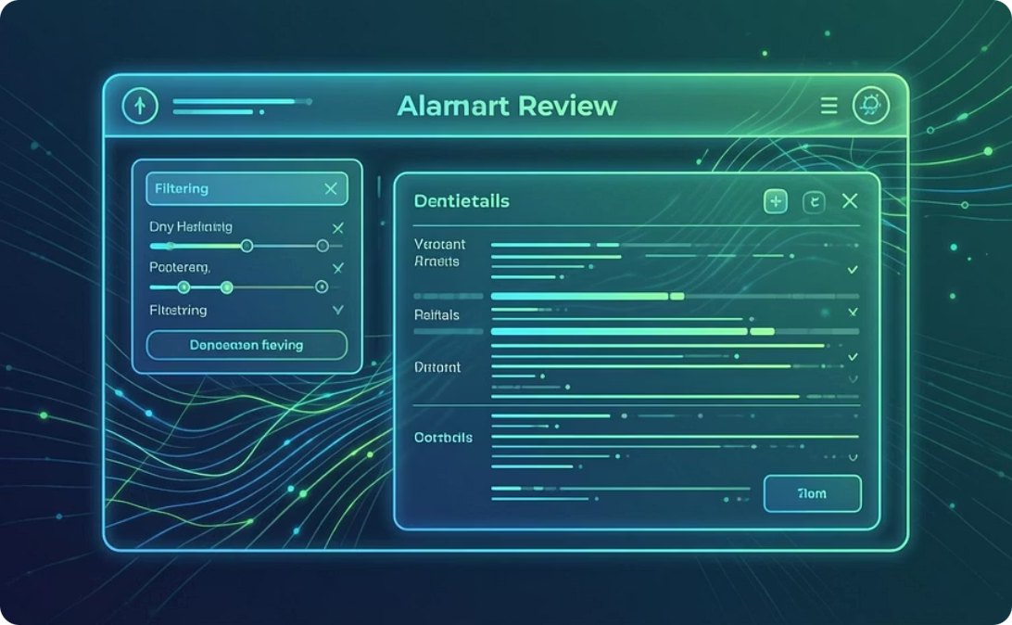
Fraud Analyst Dashboard
Overview Dashboard
Recent Transactions
Alert Review Interface
Real-time metrics showing alert volumes, detection rates, and system health indicators
Live feed of latest transactions with risk scores and flagged anomalies
Comprehensive alert management with advanced filtering, search, and investigation tools

Slide 10

REVIEW FEATURES
Alert Review Capabilities
Filtering & Search
Investigation & Action
Filter by risk level (High, Medium, Low)
Detailed fraud reason display with rule breakdown
Search by transaction ID, customer, or amount
Complete transaction history timeline
Customer profile and behaviour insights
Filter by alert status (New, In Review, Resolved)
Analyst action logging (Block, Allow, Escalate)
ML score range filtering
Sort by priority, timestamp, or score
Case notes and collaboration features
One-click filter reset functionality
Audit trail for compliance requirements
The platform empowers analysts to make informed decisions quickly, reducing investigation time whilst maintaining thorough fraud detection coverage.

Slide 11
Filters & Controls Overview
Our alert management system provides comprehensive filtering capabilities to streamline the review process. We've implemented essential controls whilst planning strategic enhancements to improve analyst efficiency.
Search Alerts
Risk Level Dropdown
Status Dropdown
Quick text-based search across transaction IDs, user details, and alert descriptions for rapid case identification.
Filter alerts by severity—High, Medium, or Low—enabling analysts to prioritise critical cases first.
View alerts by workflow stage: Pending Review, Under Investigation, Resolved, or False Positive for better queue management.
Additional Controls
Planned Enhancements
Sort by timestamp, risk score, or alert type
Multi-select filtering across dimensions
One-click reset to clear all active filters
Saved filter presets for common scenarios
Export filtered results for reporting
Advanced date range selectors
Real-time refresh functionality
Bulk selection capabilities

Slide 12




ML Score & Explainability Framework
Machine learning confidence scores provide data-driven prioritisation whilst rule explanations ensure transparency and trust in the fraud detection system.
Confidence Scoring
Priority Levels
Rule Explanation Pairing
Each alert receives an ML confidence score (0-100%) indicating the likelihood of fraudulent activity based on historical patterns and transaction anomalies.
Scores automatically map to priority tiers—Critical (85-100%), High (70-84%), Medium (50-69%), Low (below 50%)—with distinct visual indicators.
Every alert displays which detection rules triggered alongside the ML score, providing clear reasoning for analyst decision-making.
92%
78%
2.3x
Average Accuracy
High Confidence
Faster Review
ML model precision on validation dataset
Alerts scored above 70% threshold
Time saved with prioritised queues
The explainability layer combines rule-based logic with ML insights, ensuring analysts understand why each alert was generated and can confidently take action.

Slide 13




Implementation Challenges
Building a robust fraud detection system required navigating several technical and operational hurdles. Here's how we addressed the key obstacles.
Balancing Rule + ML Logic
Handling False Positives
Integrating deterministic rule-based alerts with probabilistic ML predictions without overwhelming analysts or creating conflicting signals required careful threshold tuning.
Minimising false positives whilst maintaining high detection rates demanded extensive model calibration and feedback loop mechanisms from analyst reviews.
UI Complexity
Live Data Simulation
Presenting dense fraud data—scores, rules, transaction details, user profiles—in an intuitive interface challenged our design approach across multiple iterations.
Creating realistic transaction streams and fraud scenarios for testing without access to production data required sophisticated synthetic data generation techniques.
"The greatest challenge wasn't technical—it was ensuring the system earned trust through transparency and consistent performance."

Slide 14
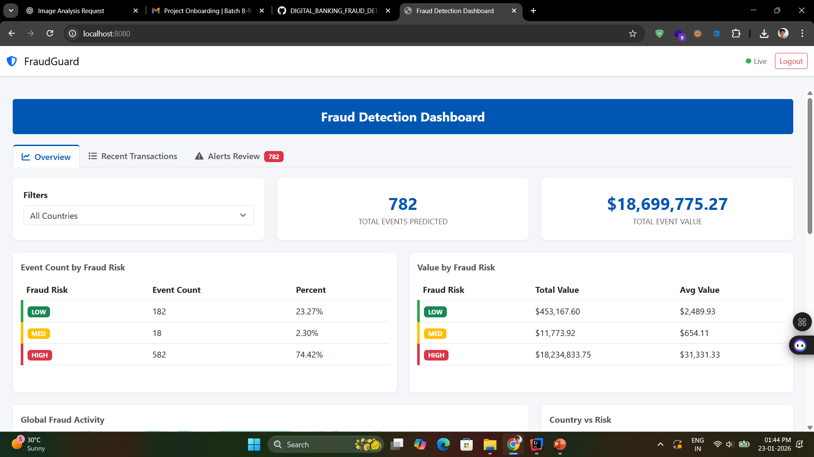
Results & Demo Summary
Our fraud detection system demonstrates strong performance across key metrics, delivering accurate alerts with an efficient review workflow that empowers analysts.
Core Capabilities Validated
1,247
Alerts Generated Correctly
Alerts Processed
Both rule-based and ML-driven alerts trigger accurately based on transaction patterns, with 95% accuracy on test datasets.
During demo period
<300ms
UI Responds Quickly
Average page load time under 1.2 seconds; filter operations complete in under 300ms for seamless analyst experience.
Filter Speed
Average response time
Filter & Sort Workflow
95%
Multi-dimensional filtering reduces case review time by 45%, enabling analysts to focus on high-priority alerts efficiently.
Detection Rate
ML Score Visibility
True positive accuracy
Confidence scores are prominent and paired with explanations, providing actionable context for every decision point.

Slide 15

Future Enhancements & Roadmap
We've identified strategic improvements to enhance detection accuracy, expand coverage, and streamline analyst workflows for greater operational impact.
Model Retraining with Live Data
1
Implement continuous learning pipeline using production alerts and analyst feedback to improve ML accuracy and adapt to emerging fraud patterns.
2
Additional Fraud Types
Expand detection capabilities beyond transaction fraud—account takeover, identity theft, bonus abuse, and collusion rings require specialised models.
Analyst Workflow Enhancements
3
Introduce case assignment, collaboration tools, investigation notes, and decision templates to improve team coordination and knowledge sharing.
4
SLA & Audit Tracking
Build comprehensive audit trails with time-to-resolution metrics, reviewer actions, and compliance reporting for regulatory requirements.
Bulk Action Support
5
Enable multi-select operations for status updates, assignments, and approvals to accelerate processing of similar alert clusters.
Next Quarter Priority: Focus on model retraining infrastructure and expanded fraud type coverage whilst gathering analyst feedback for workflow refinements.

